Slide 1
MGS 723: Geodynamics
Class 5: Elasticity II

Slide 2
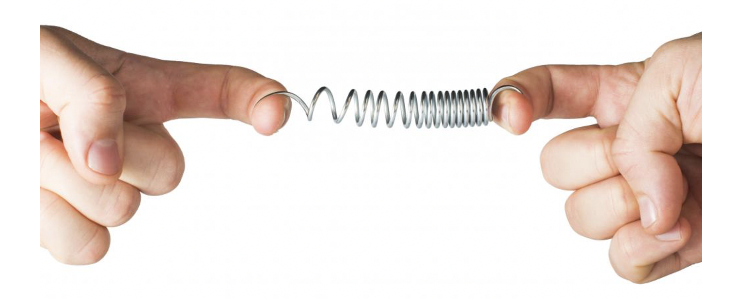

Linear isotropic elasticity
$$F=k dx$$
Hooke’s law

Slide 3
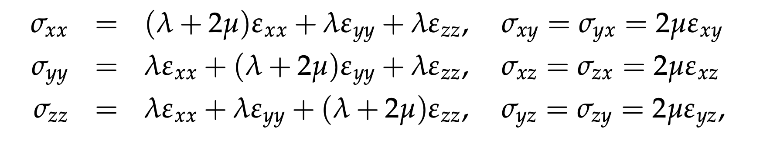
Linear isotropic elasticity

Slide 4
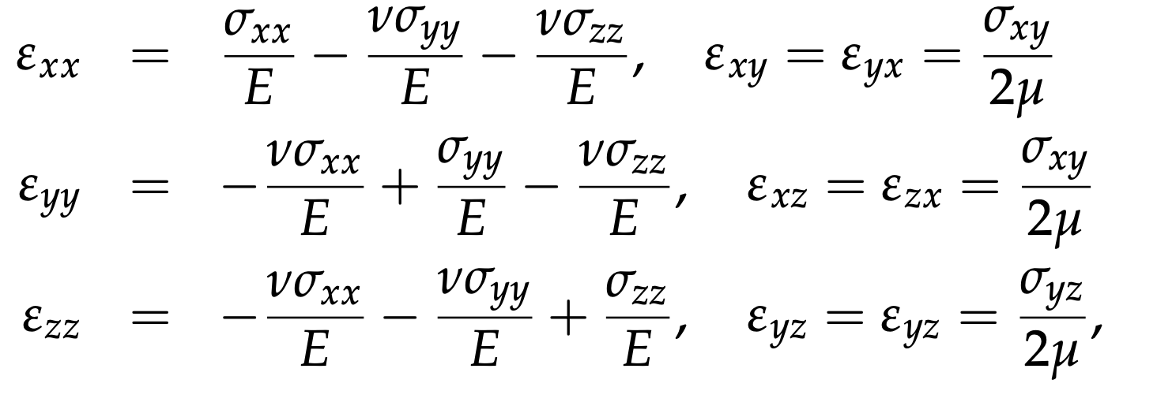
Linear isotropic elasticity

Slide 5
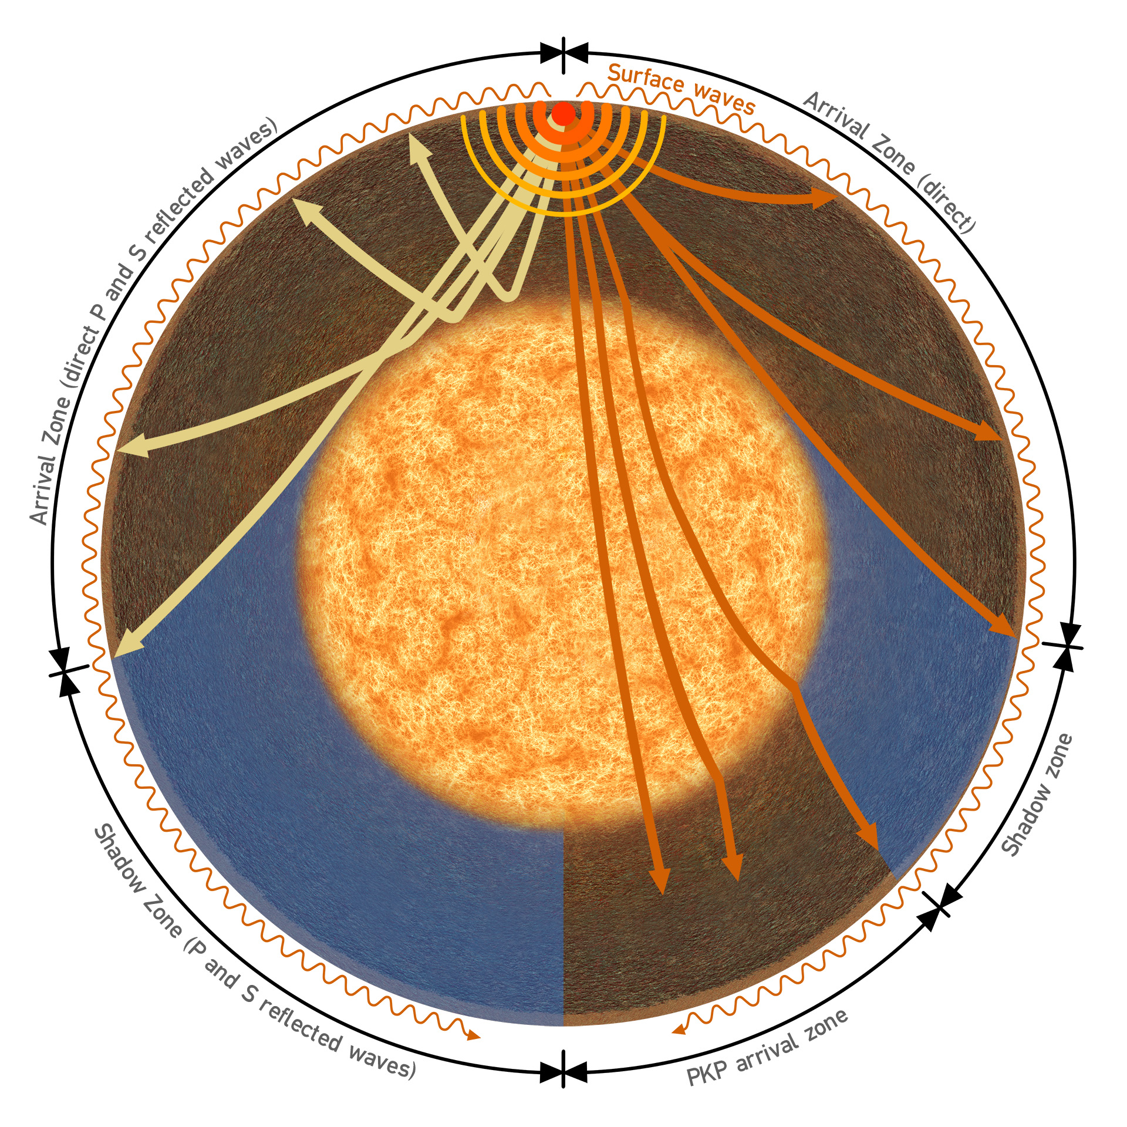
ELASTICITY in geodynamics
seismic wave propagation

Slide 6
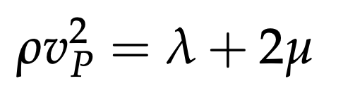
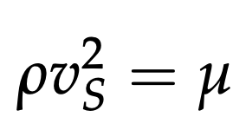
ELASTICITY in geodynamics
seismic wave propagation
We use seismic wave speeds to figure out the elastic properties of the deep Earth.

Slide 7
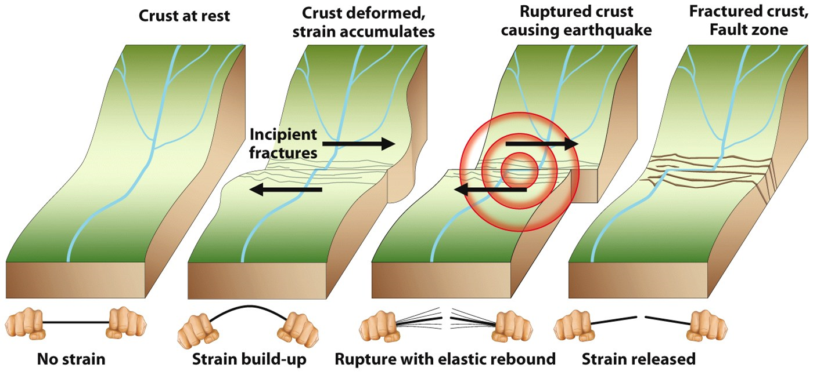
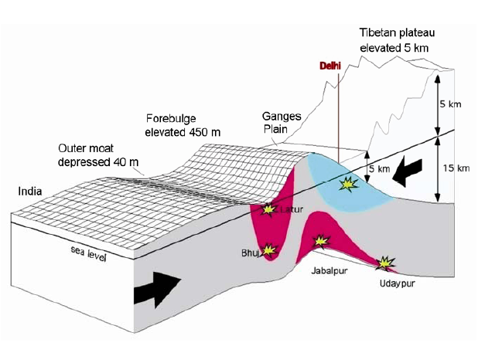
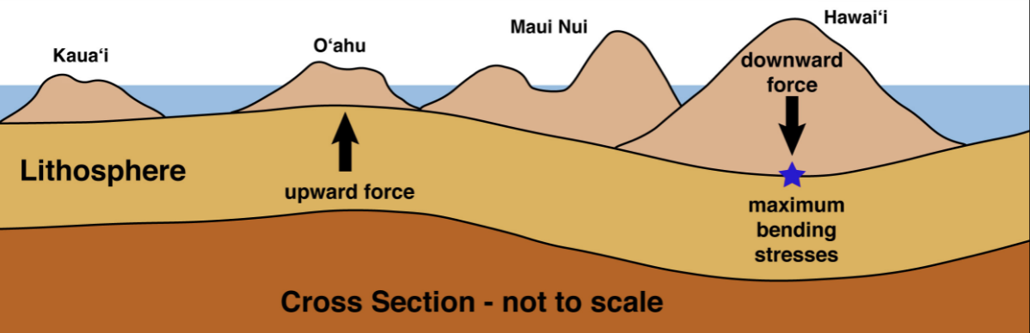
ELASTICITY in geodynamics
seismic wave propagation
Earthquake and
volcano deformation
plate flexure

Slide 8
Plate flexure
seismic wave propagation
Earthquake and
volcano deformation
plate flexure

Slide 9
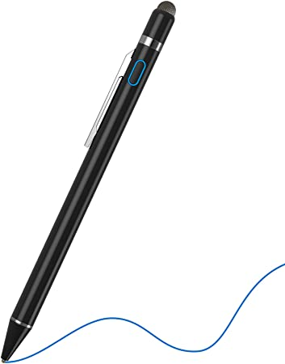
To the stylus…
To: derive the plate flexure equation and consider some idealized situations

Slide 10
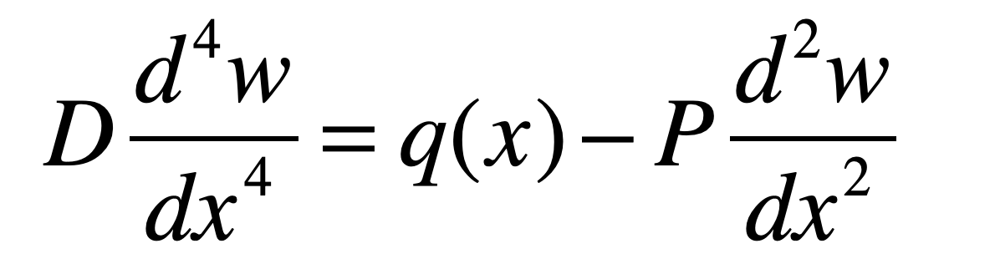
General equation for elastic plate flexure

Slide 11
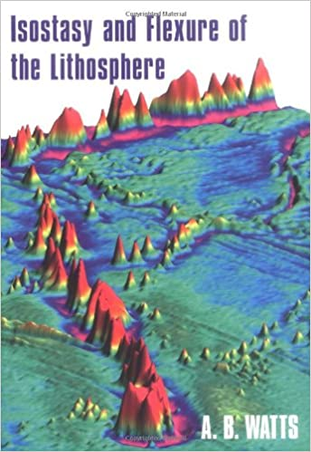
General equation for elastic plate flexure
Has underpinned many studies!
Can be adapted to account for more complex rheologies, broken plates, viscous resistance due to the surrounding mantle, ...

Slide 12
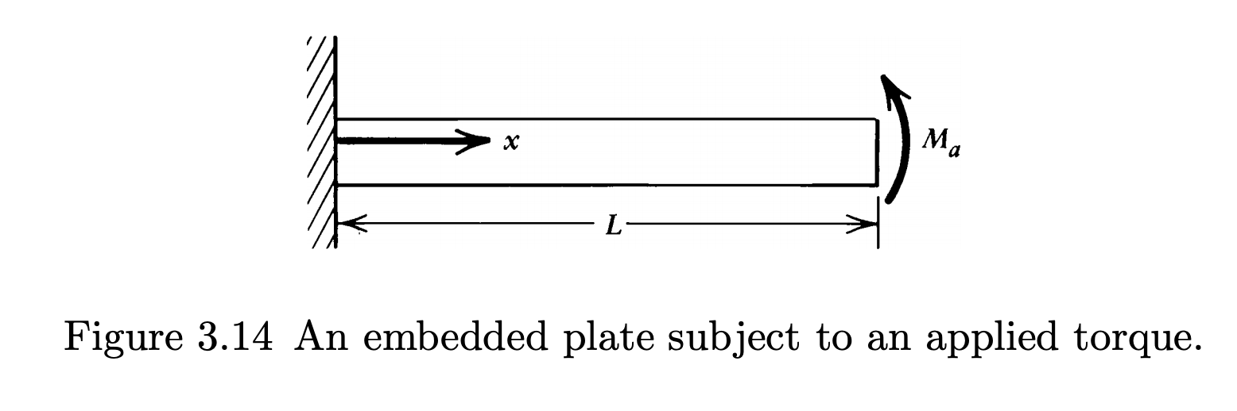
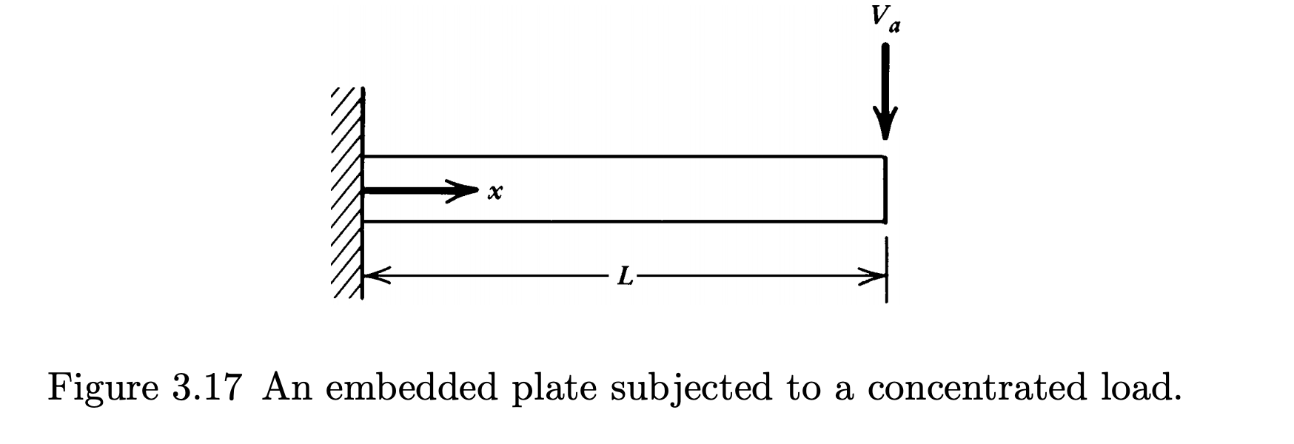
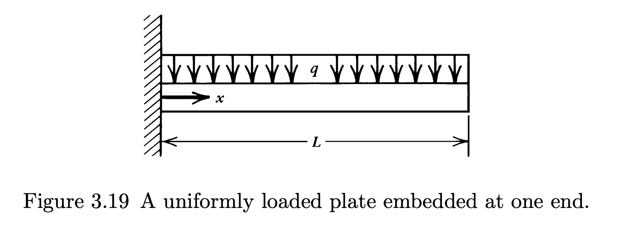
Idealized examples
Turcotte and Schubert
Notes:
Wei, M., D. Sandwell, and B. Smith-Konter (2010), Optimal combination of InSAR and GPS for measuring interseismic crustal deformation, J. Adv. in Space Res., doi: 10.1016/j.asr.2010.03.013

Slide 13
Idealized examples
How to make applicable to Earth?
Turcotte and Schubert

Slide 14
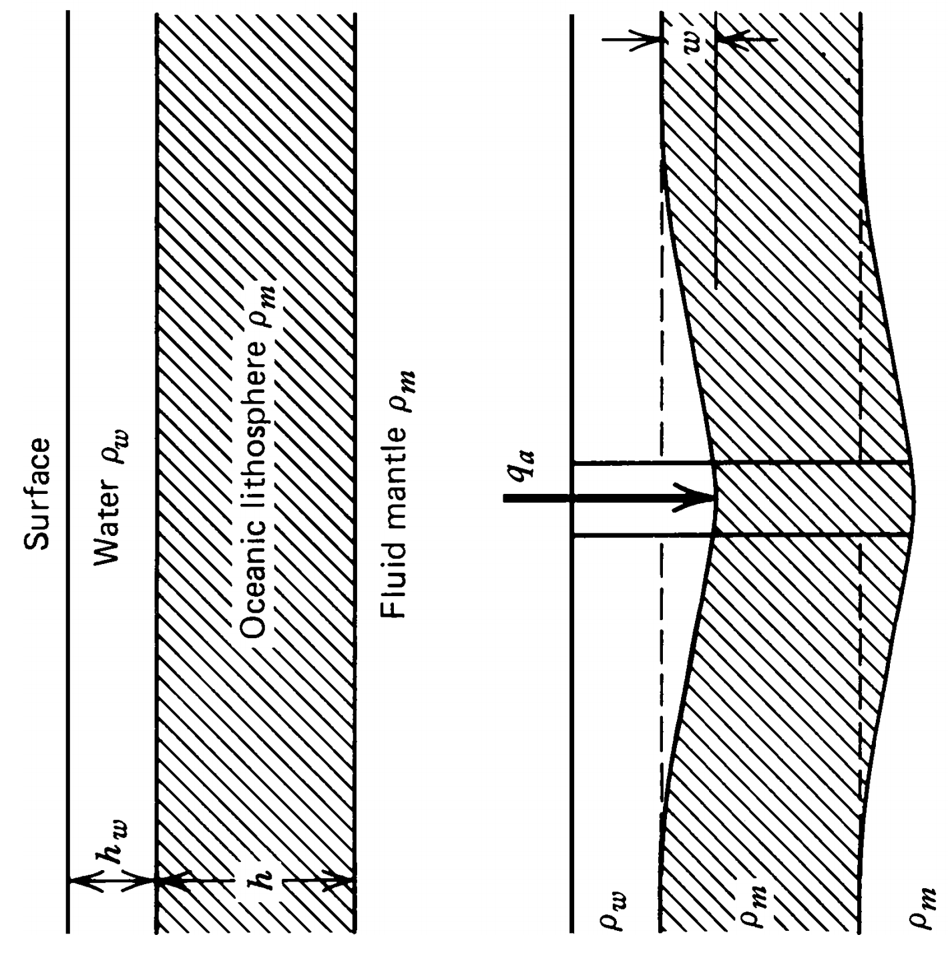
Idealized examples
How to make applicable to Earth?
In addition to the load (q_{a} ) there is a force associated with the in-fill of water:

Slide 15
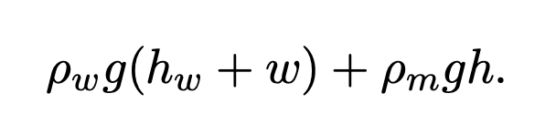
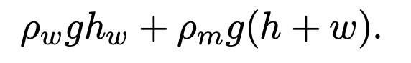
Idealized examples
How to make applicable to Earth?
In addition to the load (q_{a} ) there is a force associated with the in-fill of water:
Hydrostatic force at base of deflected lithosphere:
Hydrostatic force at same depth of undeflected lith.:

Slide 16
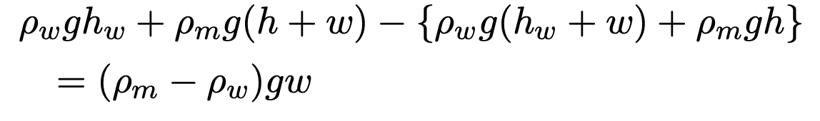
Idealized examples
How to make applicable to Earth?
In addition to the load (q_{a} ) there is a force associated with the in-fill of water:
Hydrostatic force at base of deflected lithosphere:
Hydrostatic force at same depth of undeflected lith.:
Net (upwards directed) hydrostatic force:

Slide 17
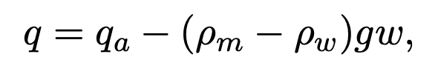
Idealized examples
How to make applicable to Earth?
The (upwards directed) hydrostatic force tends to restore the lithosphere to its original position. Net force per unit area:

Slide 18
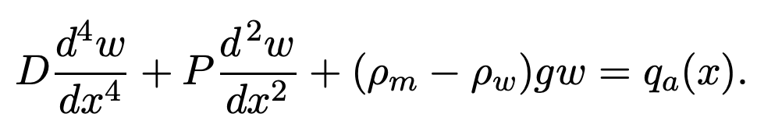
Idealized examples
How to make applicable to Earth?
The (upwards directed) hydrostatic force tends to restore the lithosphere to its original position. Net force per unit area:
So:

Slide 19
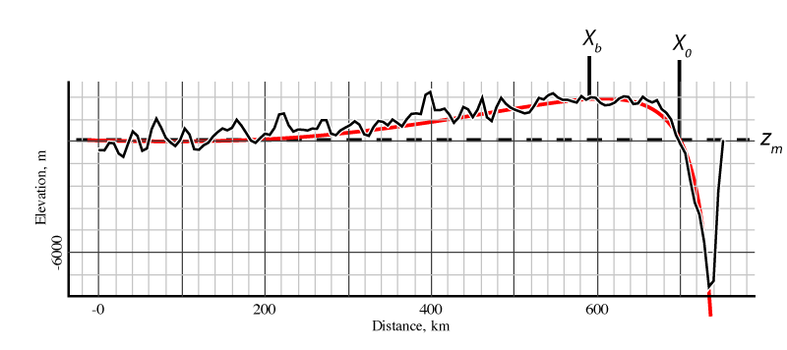
Idealized examples
How to make applicable to Earth?
Aleutian trench

Slide 20
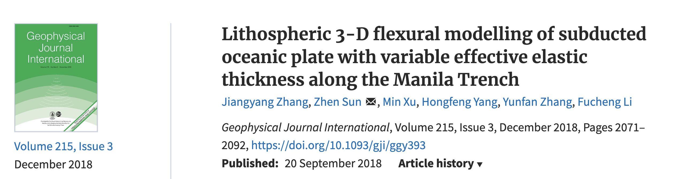
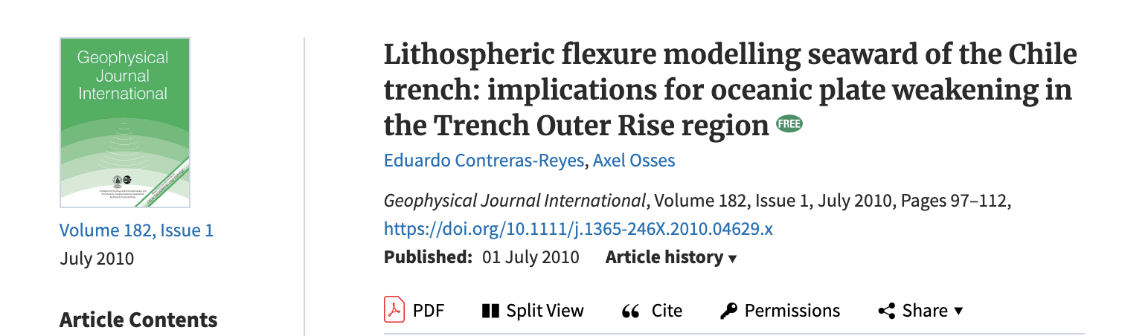
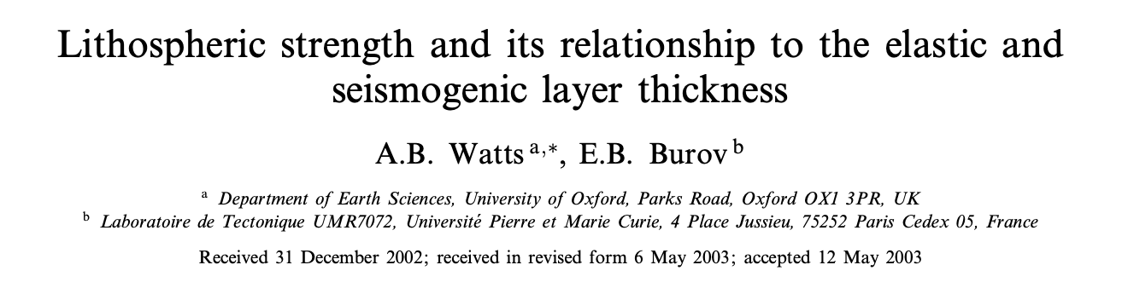
Idealized examples
How to make applicable to Earth?

Slide 21
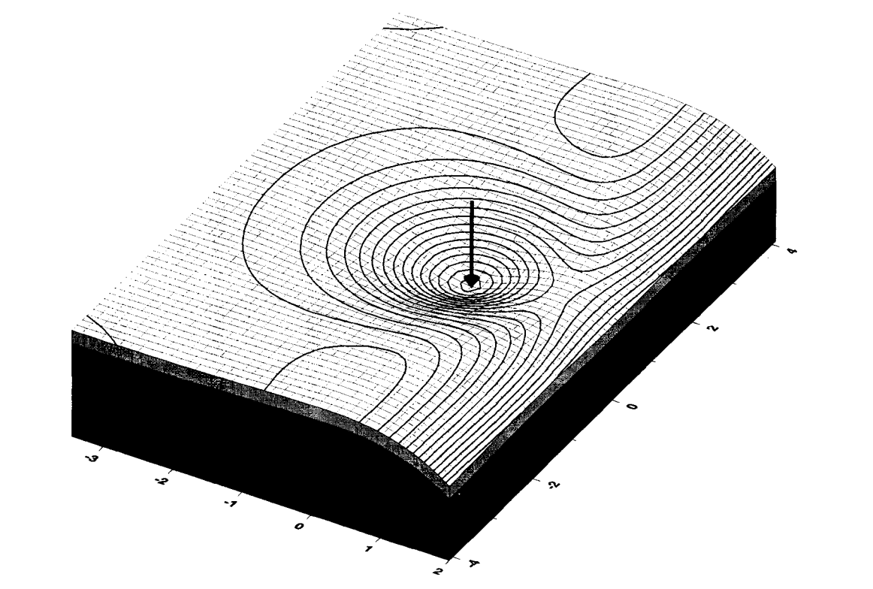
Idealized examples
How to make applicable to Earth?
Wessel, 1996

Slide 22
Take homes:
General equation for elastic plate flexure:
Assumptions
Example solutions
Modification for Earth lithosphere
Example applications include:
Subducting plates
Ocean islands
Folded strata
In all cases, can estimate the load, measure displacement, solve for plate properties.

